Slide 1
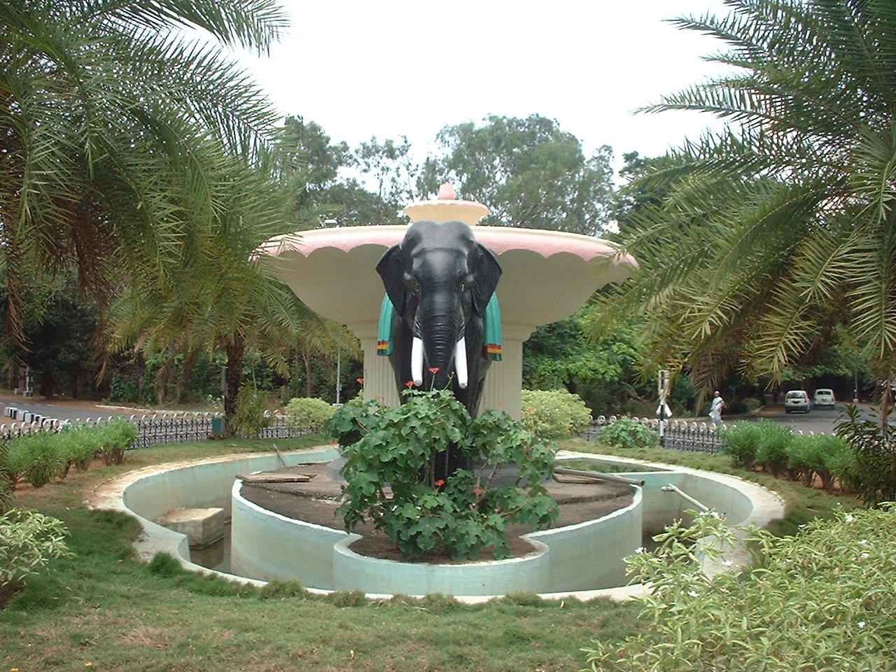
CONTROLLERS
FOR PROCESS APPLICATIONS

Slide 2
Offset in Proportional Controller demo
A cold water tank is supplied with water via a float operated control valve and with a globe valve on the outlet pipe valve ‘V’, as shown in Figure. Both valves are the same size and have the same flow capacity and flow characteristic. The desired water level in the tank is at point B (equivalent to the set point of a level controller).​ It can be assumed that, with valve ‘V’ half open, (50% load) there is just the right flowrate of water entering via the float operated valve to provide the desired flow out through the discharge pipe, and to maintain the water level in the tank at point at B.​

Slide 3
The system can be said to be in balance (the flowrate of water entering and leaving the tank is the same); under control, in a stable condition (the level is not varying) and at precisely the desired water level (B); giving the required outflow. With the valve ‘V’ closed, the level of water in the tank rises to point A and the float operated valve cuts off the water supply (see Figure). The system is still under control and stable but control is above level B. The difference between level B and the actual controlled level, A, is related to the proportional band of the control system. Once again, if valve ‘V’ is half opened to give 50% load, the water level in the tank will return to the desired level, point B.​

Slide 4
Now the valve ‘V’ is fully opened (100% load). The float operated valve will need to drop to open the inlet valve wide and admit a higher flowrate of water to meet the increased demand from the discharge pipe. When it reaches level C, enough water will be entering to meet the discharge needs and the water level will be maintained at point C.
The system is under control and stable, but there is an offset; the deviation in level between points B and C. Figure combines the three conditions used in this example.​ The difference in levels between points A and C is known as the Proportional Band or P-band, since this is the change in level (or temperature in the case of a temperature control) for the control valve to move from fully open to fully closed.

Slide 5
Weblink:
http://www.spiraxsarco.com/Resources/Pages/Steam-Engineering-Tutorials/basic-control-theory/basic-control-theory.aspx
THANK YOU

